Slide 1
Islamic Depositors Insurance Fund- The implementation
9th African Islamic Banking and Takaful Summit
July 26, 2022 at Johari Rotana, Dar-es-Salam, Tanzania
Mohamed Shakeel Salyani (PhD).
+254721858180
mshakeel.salyani@gmail.com

Slide 2
Premier provider of Islamic Banking software
Conventional Banking Software
Mobile & Internet Banking Platforms
Microfinance software
Islamic Microfinance Software
Investment Banking Software
Sister Company to Little Cabs Mobile platform

Slide 3
Agenda
What is Depositors Insurance
Why is it done
How is it done conventionally
What is Islamic Depositors Insurance Fund
The benefits of Islamic Depositors Insurance Fund.
How is it done
Where is it practiced

Slide 4
What is Depositors Insurance
is a deposit insurance scheme that protects depositors at Massachusetts savings banks
in response to the large number of Massachusetts bank failures during the Great Depression of the 1930s
All DIF member banks are also members of the FDIC. Each depositor is insured by the FDIC to at least $250,000. All deposits above the FDIC insurance amount are insured by the Depositors Insurance Fund
Currently, the maximum coverage is TZS 1.5 million per depositor per bank. Currently, the insured deposits cover 95% of insurable deposit accounts.

Slide 5
Why is it done
Assurance of security with banks
Regulatory bodies are able to calculate risks
Returns on premium enhance growth
Mitigates future risks
Enhances corporate governance

Slide 6
How is it done conventionally
Mandatory membership for all banks legally licensed to tttake deposits
Scope of coverage
deposits of physical persons and legal entities
deposits in national and foreign currency
Level of coverage
Entry premiums 1% of registered capital; to be paid within 30 days from the date of bank registration
Annual premium contributions 0.5% of total amount of previous years deposit base (insured)

Slide 7
What is Islamic Depositors Insurance Fund
4/3 The general principle is that a Mudarabah contract is not binding, i.e. 4/3 The general principle is that a Mudarabah contract is not binding, i.e. each of the contracting parties may terminate it unilaterally(AAOIFI Shariah Standards)
Insurance/ Takaful coverage of Depositors funds
Structured on a Waqf Pool
A general amount given to the depositors on a structured basis
Liquidation of assets done in a halal manner

Slide 8
The benefits of Islamic Depositors Insurance Fund.
Riba free
Customer loyalty
Dependency on the fund
Better corporate governance
Additional scrutiny on risk taking
Better risk management
Inclusion of Basel agreements with Islamic regulatory frameworks

Slide 9
B. Profit Sharing Investment Accounts(PSIA)
Source: Hamed, 2015
9

Slide 10
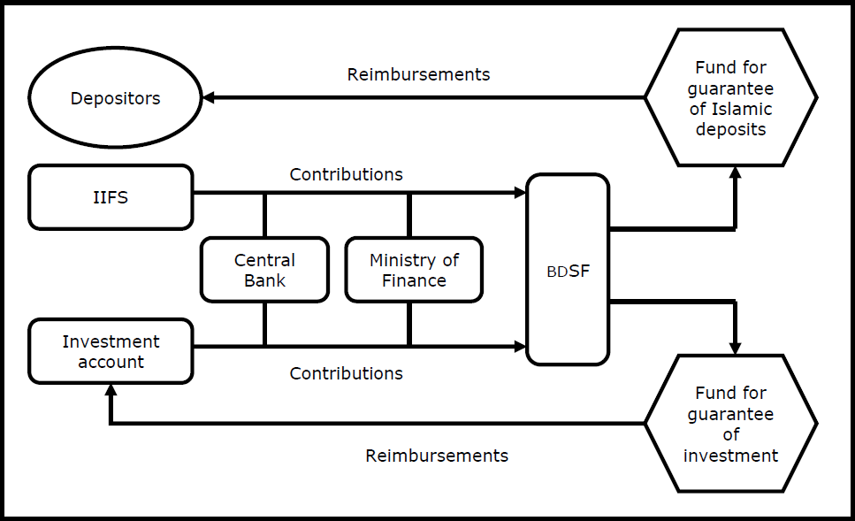
Model 1. Sudan’s IDIS based on the takaful model
Source: IADI 2014
10

Slide 11
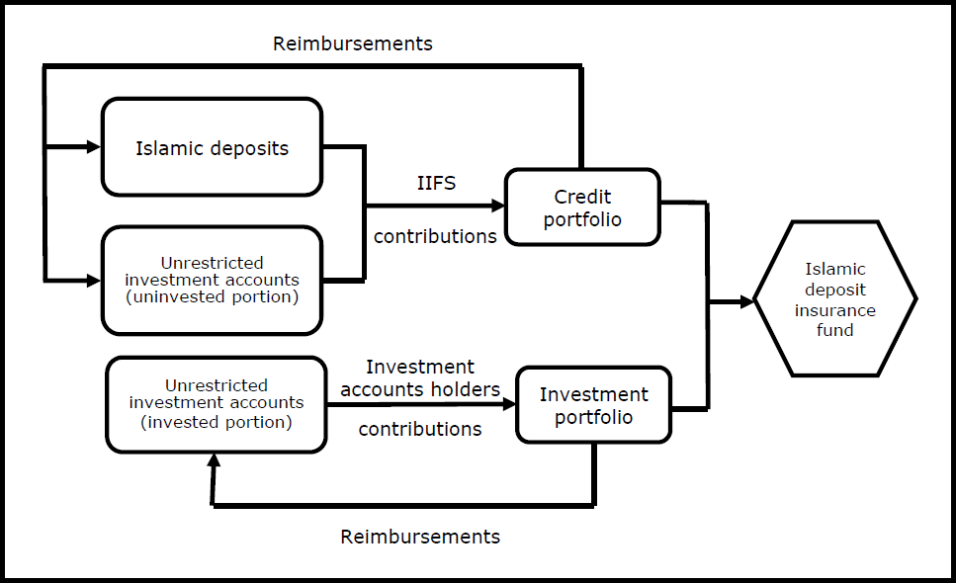
Model 2. Jordan’s IDIS based on the takaful model
Source: IADI 2014
Under Sudan & Jordan’s Takaful concepts,
Participants’ contributions are maintained in two separate Takaful funds (two
portfolios):
One for the guarantee of Islamic deposits,
The other for the guarantee of all investment accounts(PSIA) in Sudan
and the unrestricted portion of the PSIA in Jordan
11

Slide 12
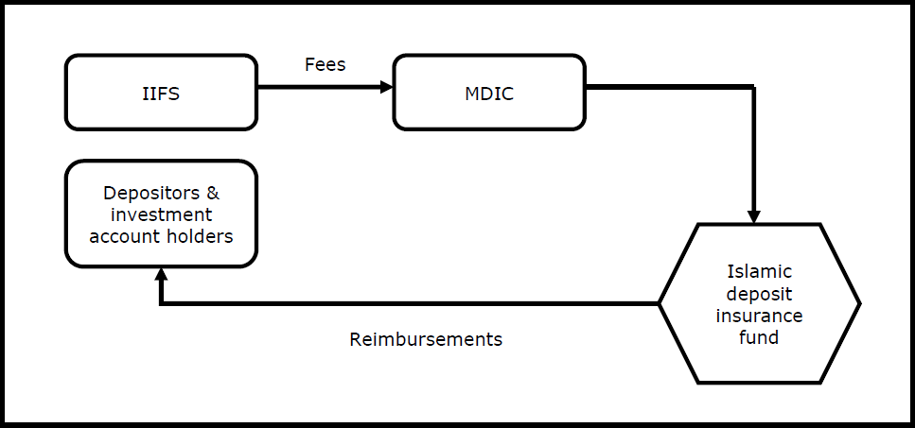
Model 3. Malaysia’s IDIS based on the kafala model
Source: IADI 2014
12

Slide 13
C. Fund contribution
The main differences between Takaful and Kafala(bil ujr) models
Source: Hamed, 2015
13

Slide 14
Reference
J. Hamed, “Essential Elements for Effective Islamic Deposit Insurance
Systems: ShariahGovernance, Sources and Management of Funds”, 2015, IADI seminar
Islamic Deposit Insurance Group, “Shari’ah Approaches for the Implementation of Islamic Deposit Insurance Systems”, 2014, IADI
R.A. Kadir, “Managing Islamic Deposit Insurance in a Dual Banking System: the Malaysian Experience” 2014, Bank Negara Malaysia, IADI Annual Conference
S. Hamisu, R. Hassan, “Depositors Protection Scheme: Appraisal of Islamic Banks Participation in Deposit insurance System”, 2017, Journal of Islamic Banking & Finance, Vol.5, #1, pp.15-25
S. Abubakar, L. Olorogun, “Concept of Deposit Insurance: A Comparative
Study between Conventional System and Shariah”, 2016, Journal of Business &
Management, Vol.18, Issue10, pp.90-97
16

Slide 15
Mohamed Shakeel Salyani (PhD).
+254721858180
mshakeel.salyani@gmail.com

